Slide 2
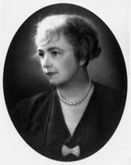
“The Little Drummer Boy” was written by Katherine K Davis. Davis made her mark as a music education teacher and composer at Concord Academy and Wellsley College in Concord, Mass.
In 1941, while trying to take a nap, a new melody kept running though her head. She ran downstairs and wrote the new tune down and titled it “The Carol of the Drum”. She later stated that the “words practically wrote themselves!”

Slide 3
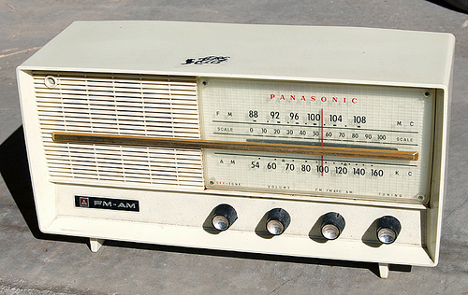
Then during the holidays of 1959, a friend called Davis on the telephone and told her that her carol was on the radio. Davis responded , “What carol?”, and her friend replied, “The Little Drummer Boy!”. The perplexed Davis turned on the radio to listen to a beautiful recording of the song she had composed 18 years earlier.

Slide 4
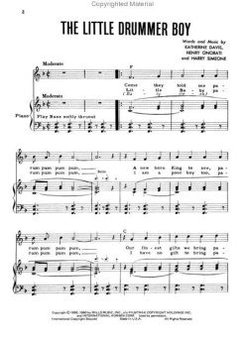
There were a few notes and words that had been changed, but it was clearly her composition. She promptly called the radio station and declared, “That is my song you are playing!”. Eventually, after solving some legal issues, Katherine K. Davis’s, music publisher was able to have her name credited to one of the most beloved Christmas songs of our time.

Slide 5
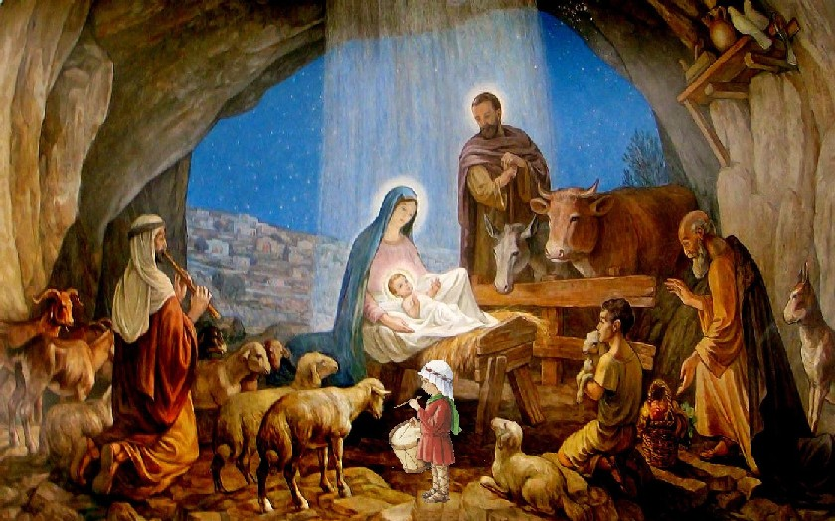
The Little Drummer Boy is the story of a poor boy who is asked to join the Magi to give a gift to the infant Jesus.

Slide 6
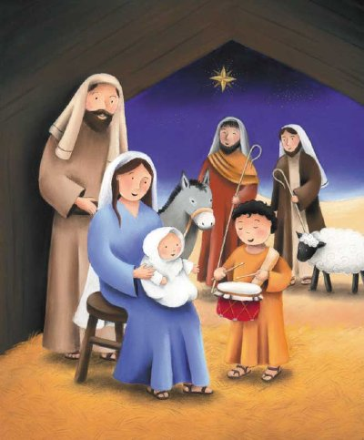
The boy has no gift for the child, so with the approval of the Virgin Mary, he plays his drum as a musical offering.

Slide 7
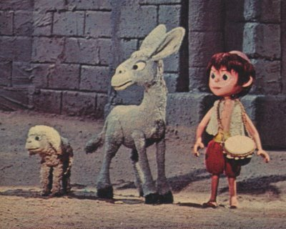
Renditions of this song have been popularized by numerous artists including The Trapp Family Singers, The Harry Simeone Chorale, Jimi Hendrix, and Bing Crosby featuring David Bowie.
Now, with
my brother, Jaden
on Drums,
I will sing:
“The Little Drummer Boy”

Slide 8
