Slide 2
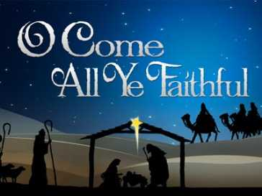

Slide 3
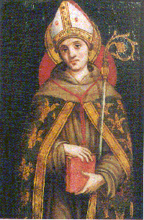
The writer of Adeste Fideles -Oh Come All Ye Faithful- was unknown for years, and was thought to be Saint Bonaventure, the 13th century Italian scholar.

Slide 4
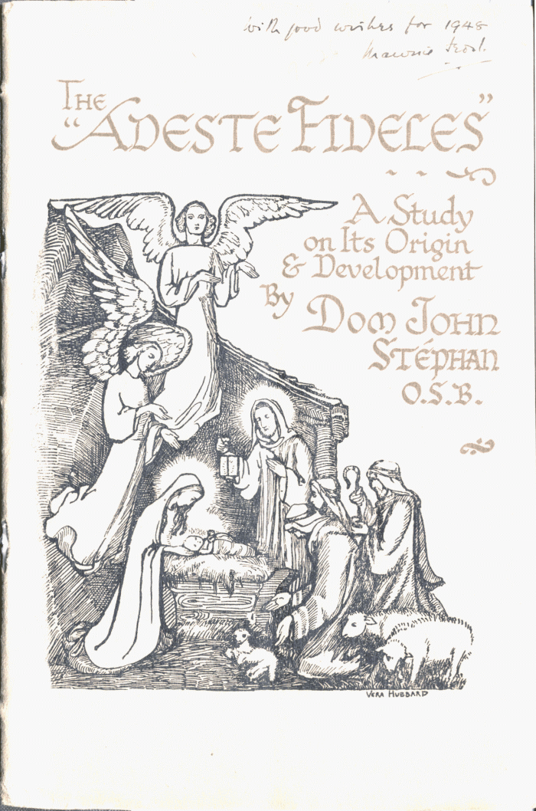
But in 1946, a new manuscript of the hymn (written in Latin) was discovered, and experts concluded that the hymn and the tune were both written by the same man.

Slide 5
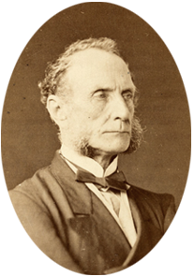
John Francis Wade, born in 1711 in England, the Catholic son of a cloth merchant, who moved to France.
Wade made his living by copying and selling plain chant and other music, and teaching Latin and Church songs.

Slide 6
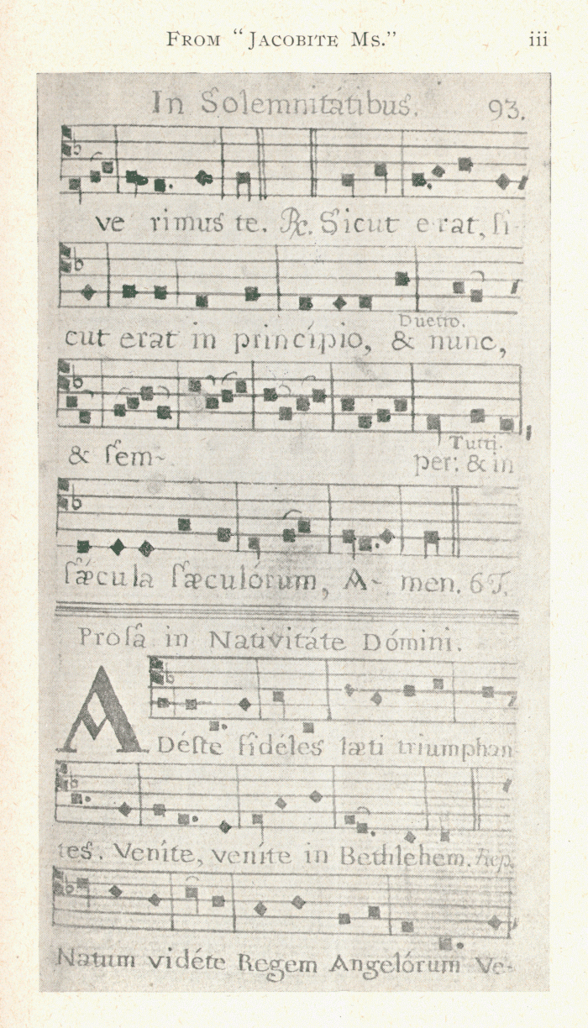
Here were his Latin words:
1. Adeste fideles laeti triumphantes, Venite, venite in Bethlehem. Natum vidéte Regem Angelorum: Venite, adorate: Venite, adorate Venite, adorate Dominum.

Slide 7
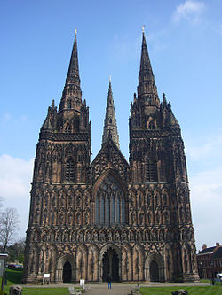
In 1841, Reverend Frederick Oakeley translated the Latin hymn Adeste Fideles into English - Oh Come All Ye Faithful.
He did this at Margaret Street Chapel, London, while he
was a senior member of clergy, at Lichfield Cathedral!

Slide 8
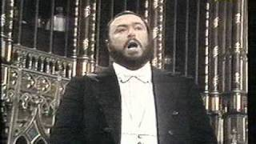
We will now hear the hymn beautifully sung in Latin by Luciano Pavorotti.

