Slide 1
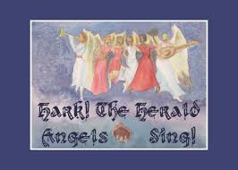

Slide 2
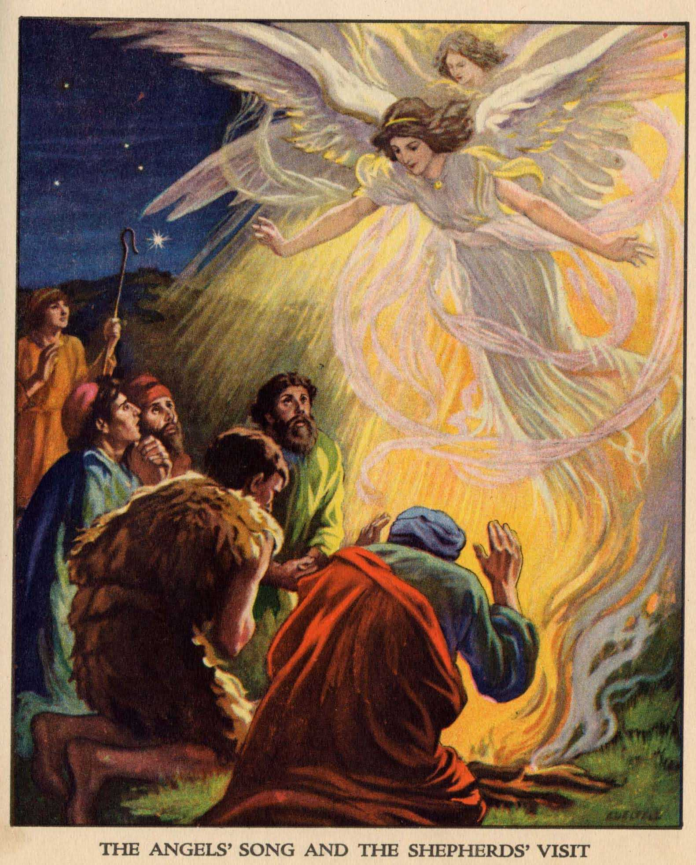
Hark the Herald Angels Sing was a poem written by Charles Wesley, brother of John Wesley the founder of the Methodist church, in 1739.
It started out “Hark how all the welkin rings/ Glory to the King of kings”. Welkin is an old Anglo-Saxon word for the vault of heaven where the angels dwell, not a very familiar word to most of us.

Slide 3
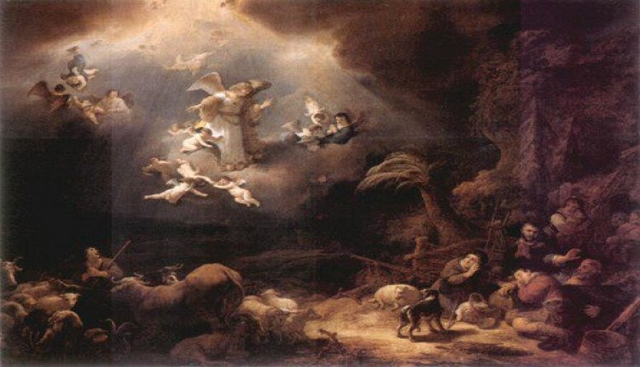
A contemporary English evangelist, George Whitefield, changed the words to what we are now familiar with “Hark the Herald Angels Sing/ Glory to the newborn King”. The word still had no music to go with them. Wesley made it known that he wanted his words paired with slow, solemn music.

Slide 4
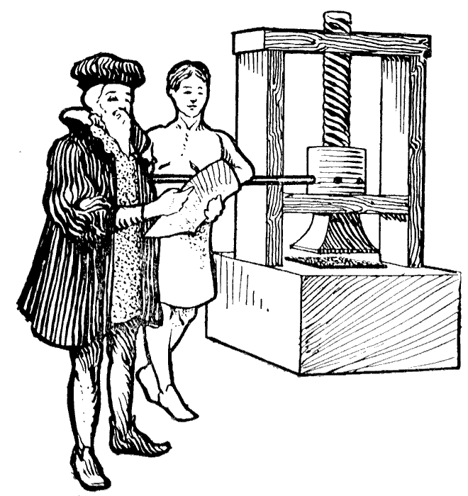
Around 1840 Felix Mendelssohn composed a tune to commemorate the 400th anniversary of the invention of the printing press.

Slide 5
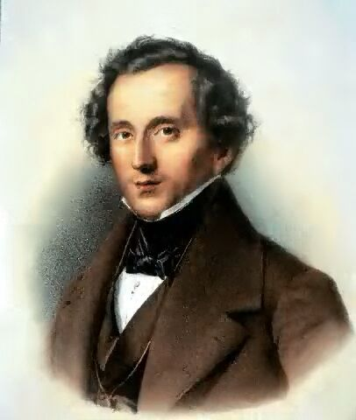
Mendelssohn was insistent that his music not be used for religious purposes.

Slide 6
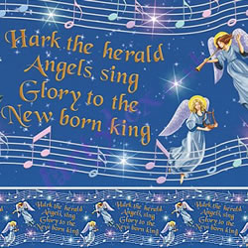
Little did he know that in 1855, when Wesley and Mendelssohn were both dead, English musician William Cummings would use that tune and fit it to the lyrics of Hark the Herald Angels Sing to celebrate the birth of Christ!
Please listen as The St. Michael’s choir sings.

Slide 8
Hark! The herald angels sing
Glory to the new-born King!
Peace on earth and mercy mild,
God and sinners reconciled!
Joyful, all ye nations rise,
Join the triumph of the skies;
With the angelic host proclaim
Christ is born in Bethlehem!
Hark! The herald angels sing
Glory to the new born King!
Christ, by highest heaven adored;
Christ the everlasting lord;
Late in time behold him come
Offspring of the Virgin’s womb.
Veiled in flesh the Godhead see;
Hail the incarnate Deity,
Pleased as man with man to dwell; Jesus, our Emmanuel!
Hark! The herald angels sing
Glory to the new-born King!

