Slide 2
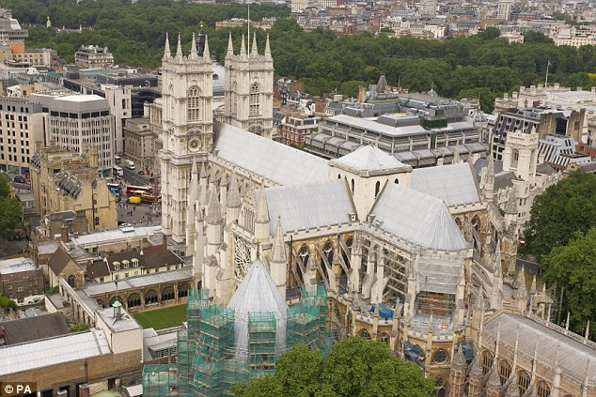
The author of the words to Joy to the World is honored with a memorial in London’s Westminster Abbey,

Slide 3
They were written and published in 1719 by Isaac Watts “the Father of English Hymnody”

Slide 4
George Friedric Handel also buried there, may have contributed the first four notes of music as part of oratorio to The Messiah.

Slide 5
Lowell Mason adapted and arranged the music as we know it today, perhaps giving Handel more credit than deserved for four notes. Mason began by writing music in Savannah, Georgia. Mason heartily endorsed congregational singing (although not to the exclusion of choirs), and to that end advocated the musical training of children.

Slide 6
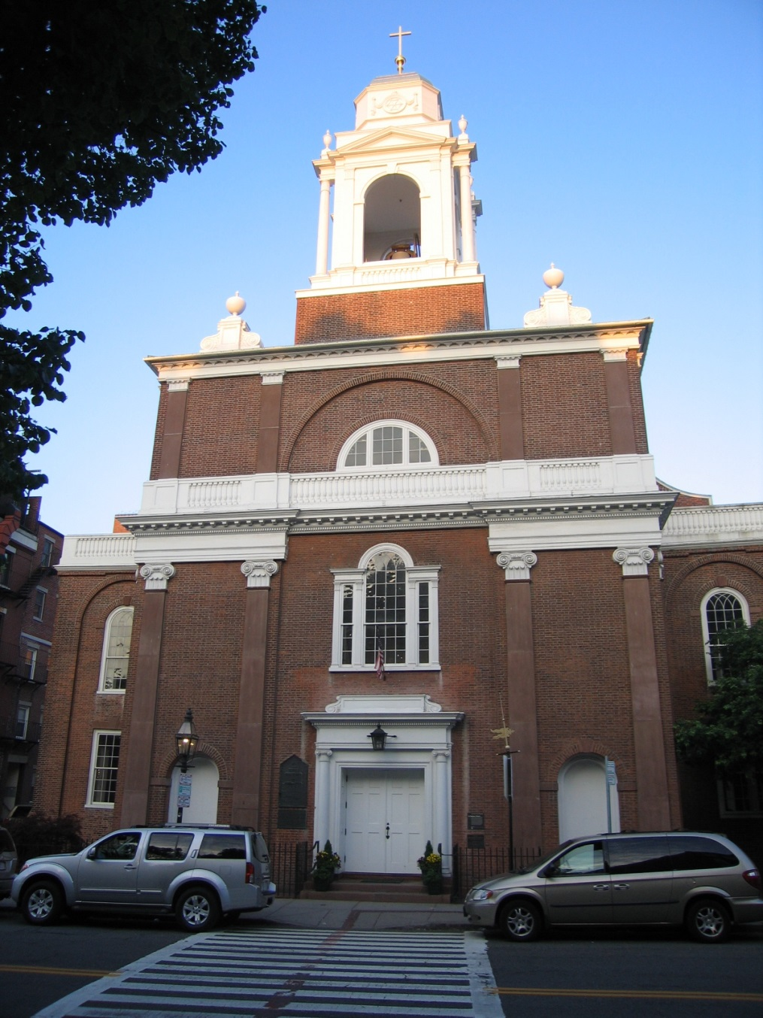
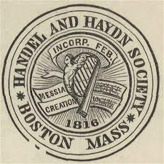
In 1822, the organist of the Boston Handel and Haydn
Society
published
Lowell’s
Music.
The collection of hymn tunes became an instant hit.
Mason was invited by
The Hanover Street Church (now known as St. Stevens)
to deliver a music lecture.
.

Slide 7
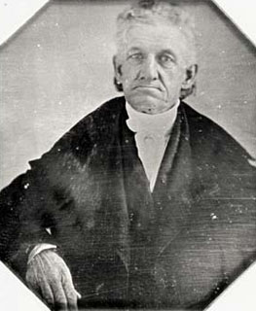
The Pastor of the Hanover Street Church was Lyman Beecher, formerly of Litchfield, Connecticut.
Lowell Mason’s "Address on Church Music," published that same year, contained an enthusiastic plea for better choirs and organs.
.

Slide 8
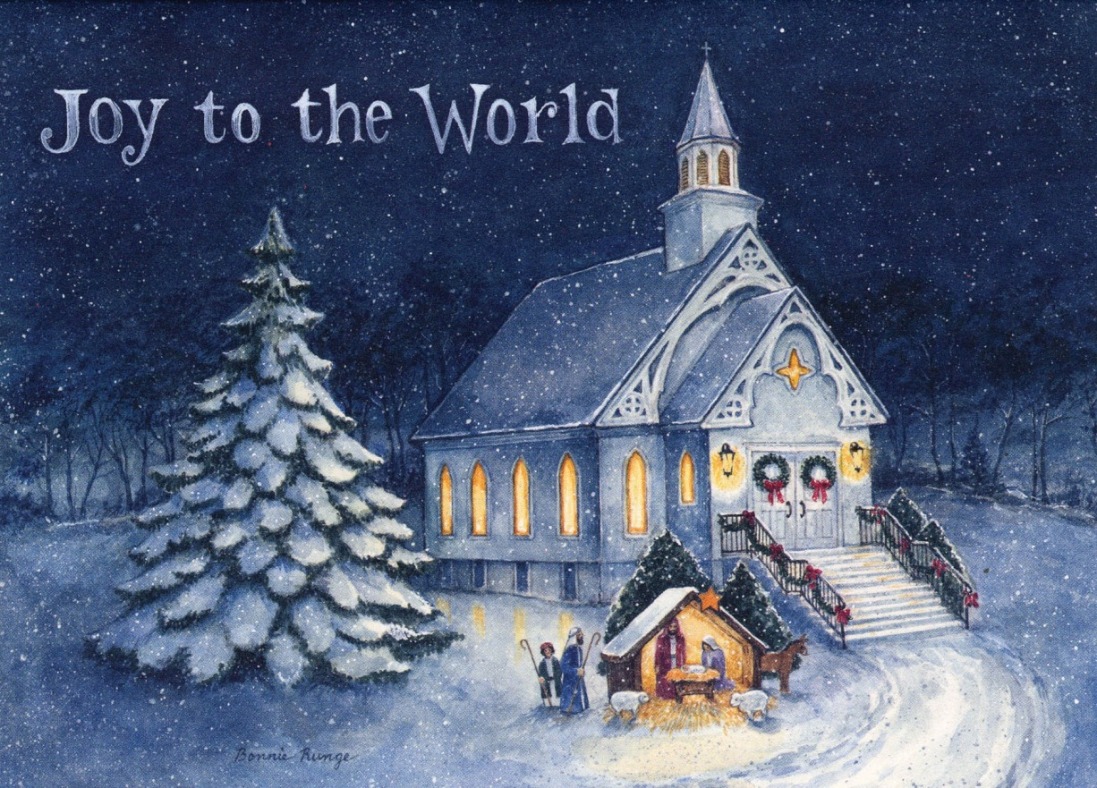
As a result of Mason’s work, choirs began rehearsing twice a week and church music was greatly enhanced throughout the country.
He resettled in Boston, and in 1839,
as a Boston Music teacher, Lowell Mason published
Joy to the World.
Today he is known as the Father of Public School Music Education.

Slide 9
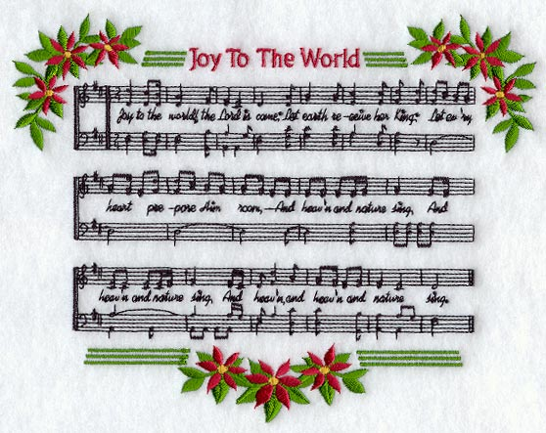
Please listen as The St. Michael’s Choir sings it for us.

Slide 10
Joy to the World! The Lord is come; Let earth receive her King; Let every heart prepare him room, And heaven and nature sing, And heaven and nature sing, And heaven, and heaven and nature sing. Joy to the earth! The Savior reigns; Let men their songs employ; While fields and floods, | Rocks, hills and plains Repeat the sounding joy. Repeat the sounding joy, Repeat, repeat the sounding joy. He rules the world with truth and grace, And makes the nations prove The glories of His righteousness, And wonders of His love, And wonders, wonders of his love.
2. Joy to the World Joy to the World! The Lord is come; Let earth receive her King; Let every heart prepare him room, And heaven and nature sing, And heaven and nature sing, And heaven, and heaven and nature sing. Joy to the earth! The Savior reigns; Let men their songs employ; While fields and foods, | Rocks, hills and plains Repeat the sounding joy. Repeat the sounding joy, Repeat, repeat the sounding joy. He rules the world with truth and grace, And makes the nations prove The glories of His righteousness, And wonders of His love, And wonders, wonders of his love.

