Slide 1
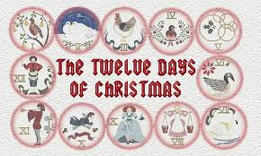

Slide 2
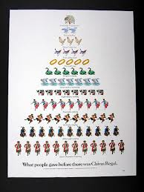
http://www.jmm.org.au/articles/18762.htm
Sometime after 1558, when Roman Catholics in England were not permitted to practice their faith openly, this carol was written as a catechism song for youngsters to remember.

Slide 3
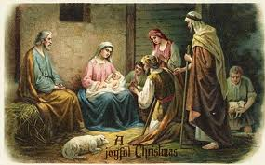
Each element in the carol has a code word for a religious reality, which the children could remember.

Slide 4
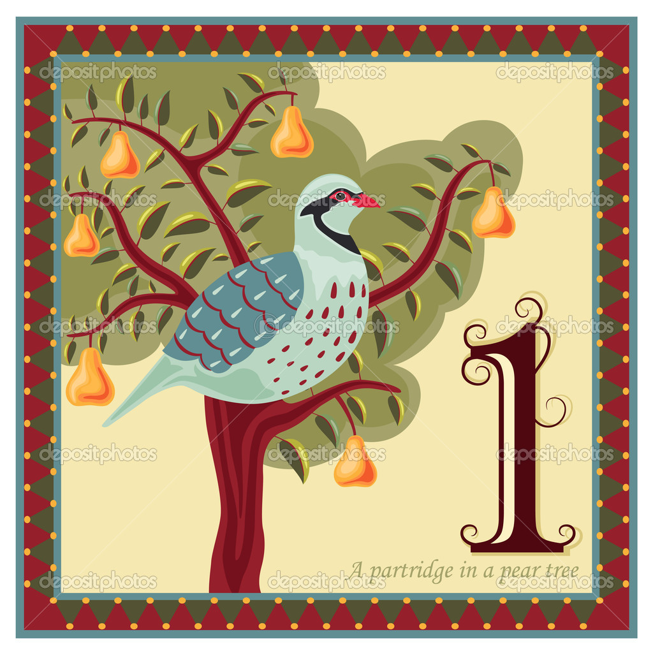
The partridge in a pear tree was Jesus Christ.

Slide 5
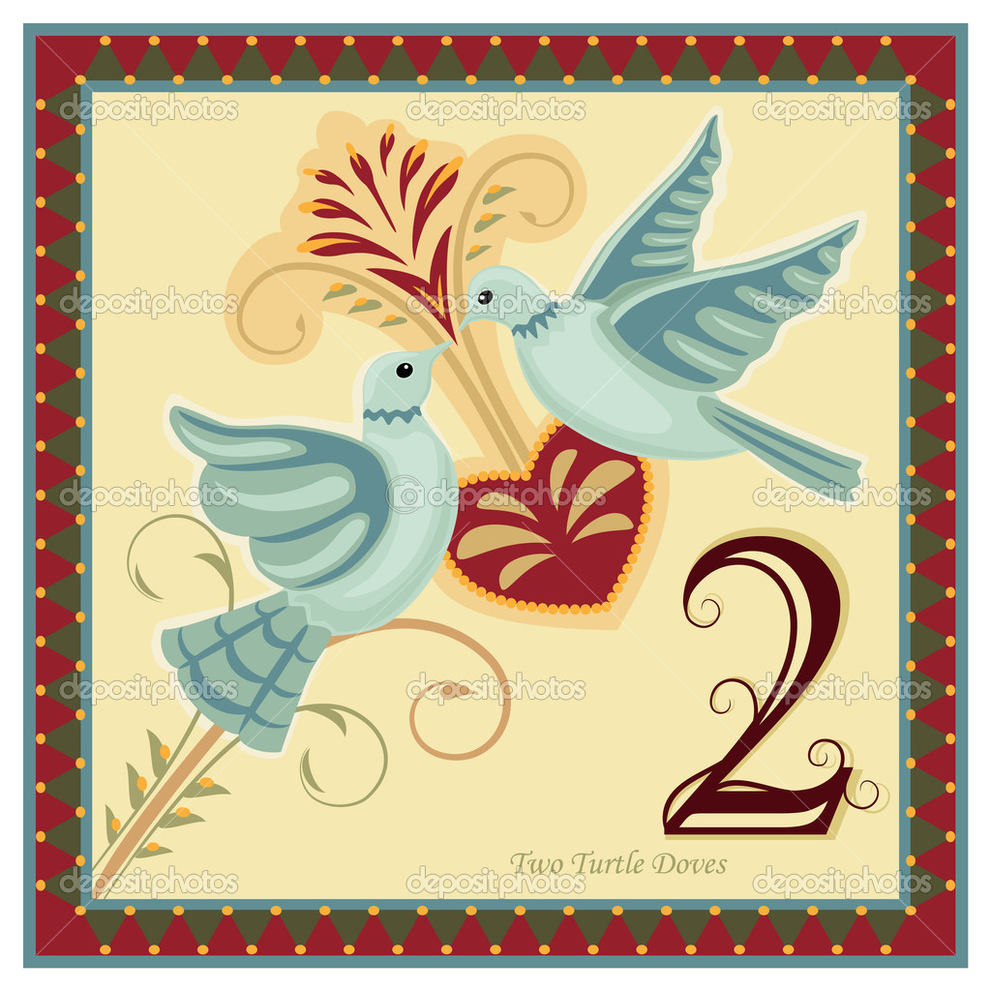
Two turtle doves were the Old and New Testaments.

Slide 6
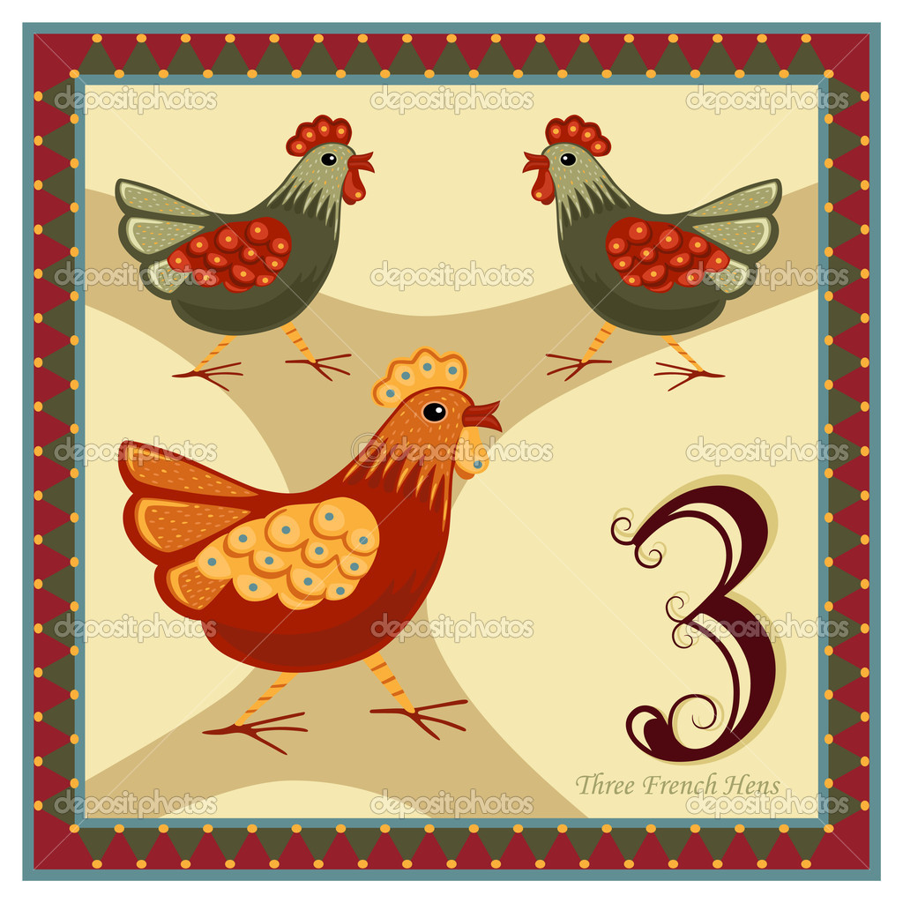
Three French hens stood for faith, hope and love.

Slide 7
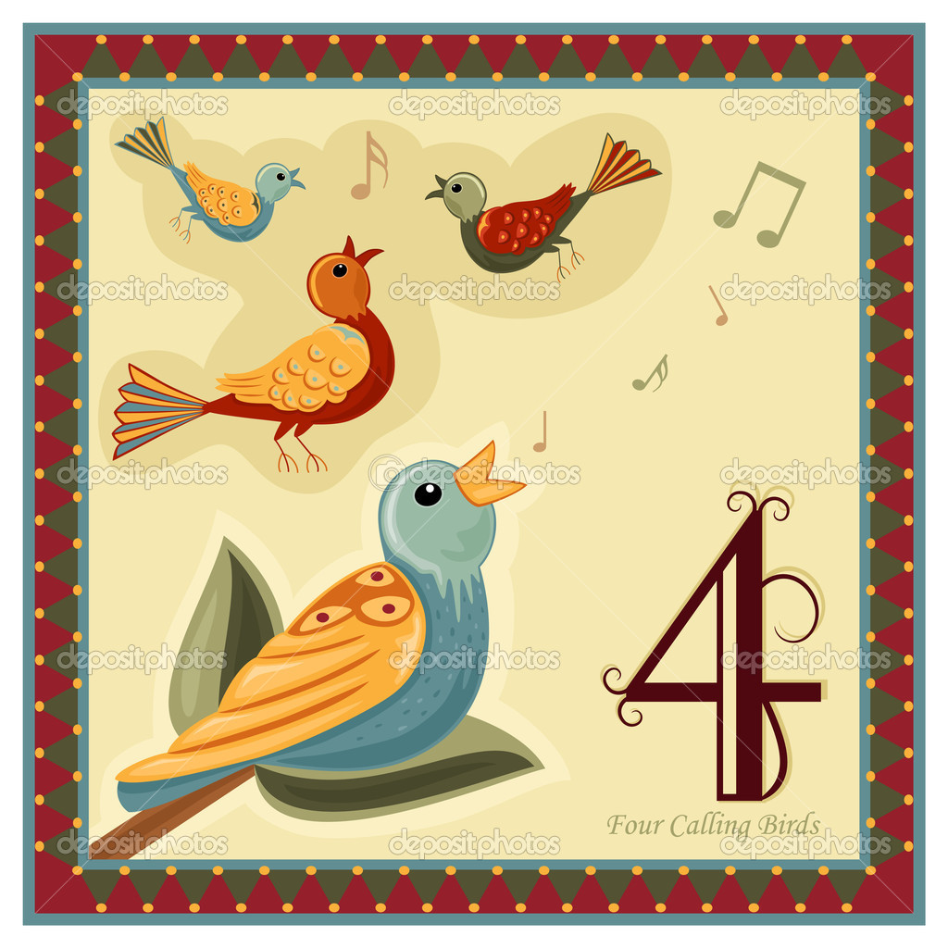
The four calling birds were the four gospels of Matthew, Mark, Luke, and John.

Slide 8
The five golden rings recalled the Torah or Law, the first five books of the Old Testament.

Slide 9
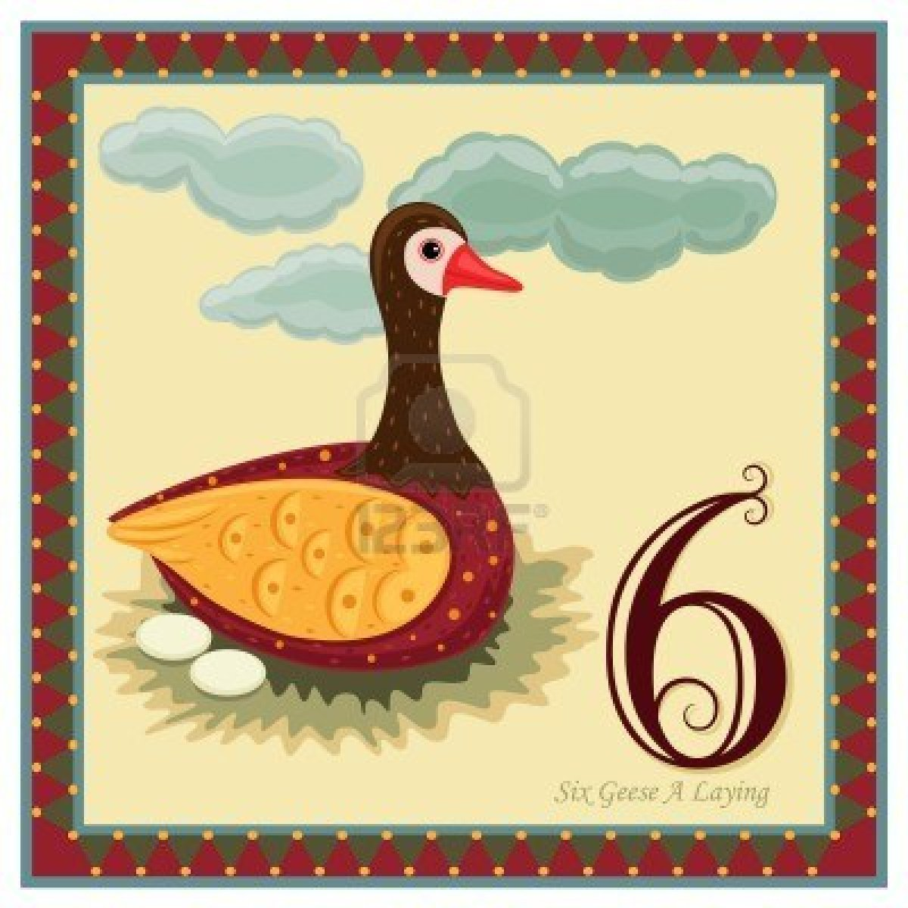
The six geese a-laying stood for the six days of creation.

Slide 10
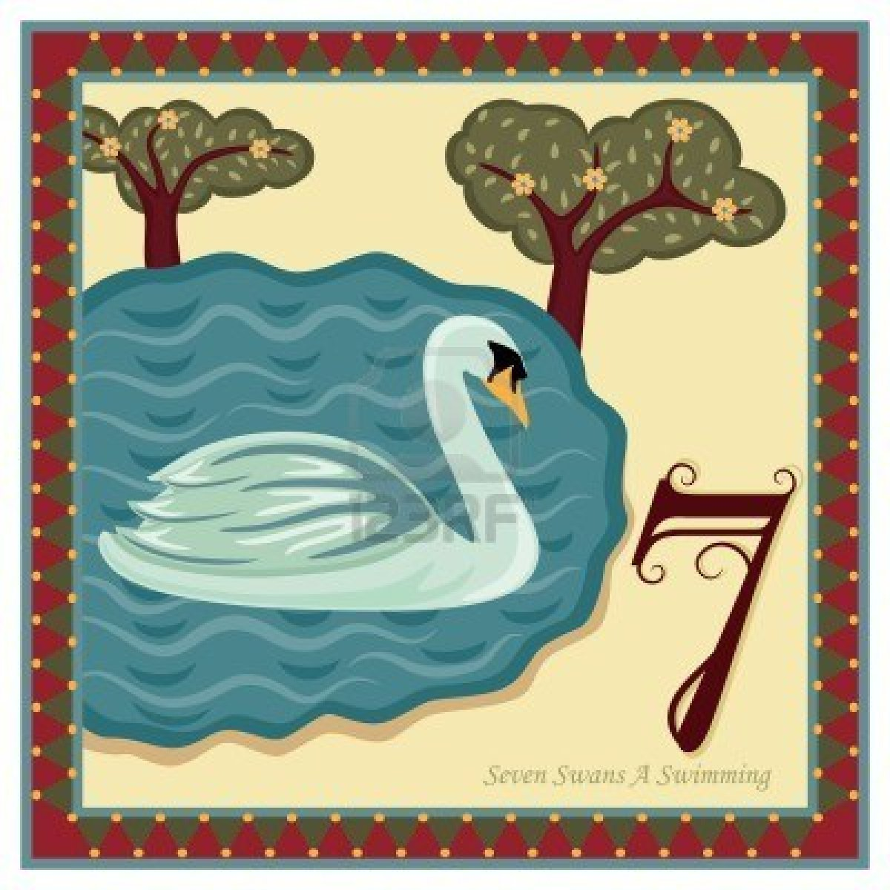
Seven swans a-swimming represented the sevenfold gifts of the Holy Spirit: Prophesy, Serving, Teaching, Exhortation, Contribution, Leadership, and Mercy.

Slide 11
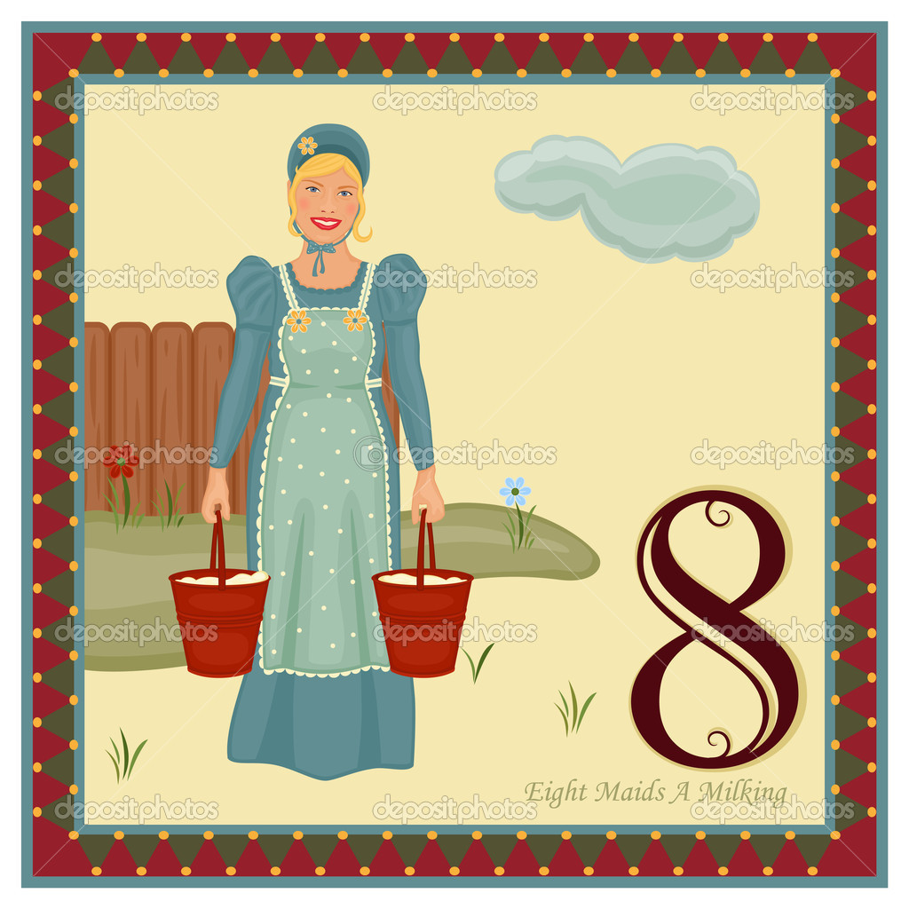
The eight maids a milking were the eight beatitudes.

Slide 12
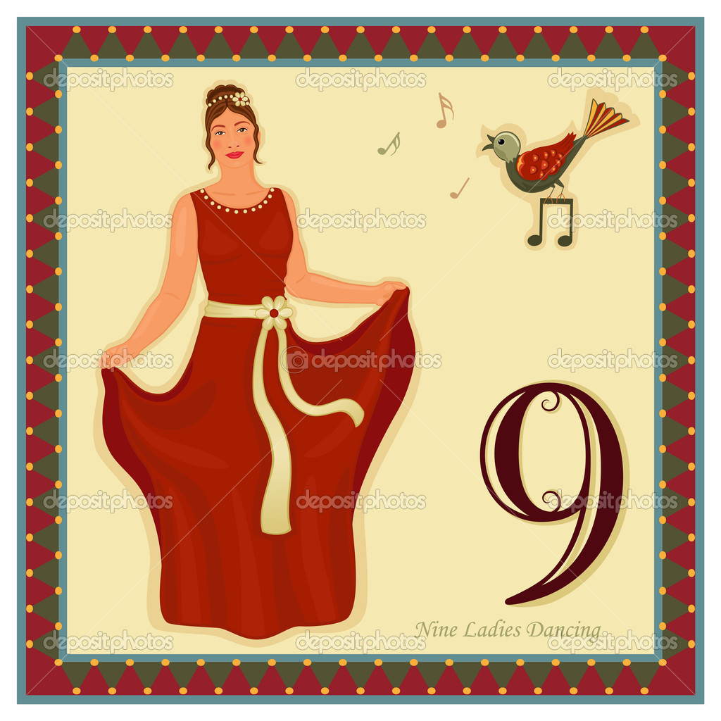
Nine ladies dancing were the nine fruits of the Holy Ghost: Love, Joy, Peace, Patience, Kindness, Goodness, Faithfulness, Gentleness, Self-control.

Slide 13
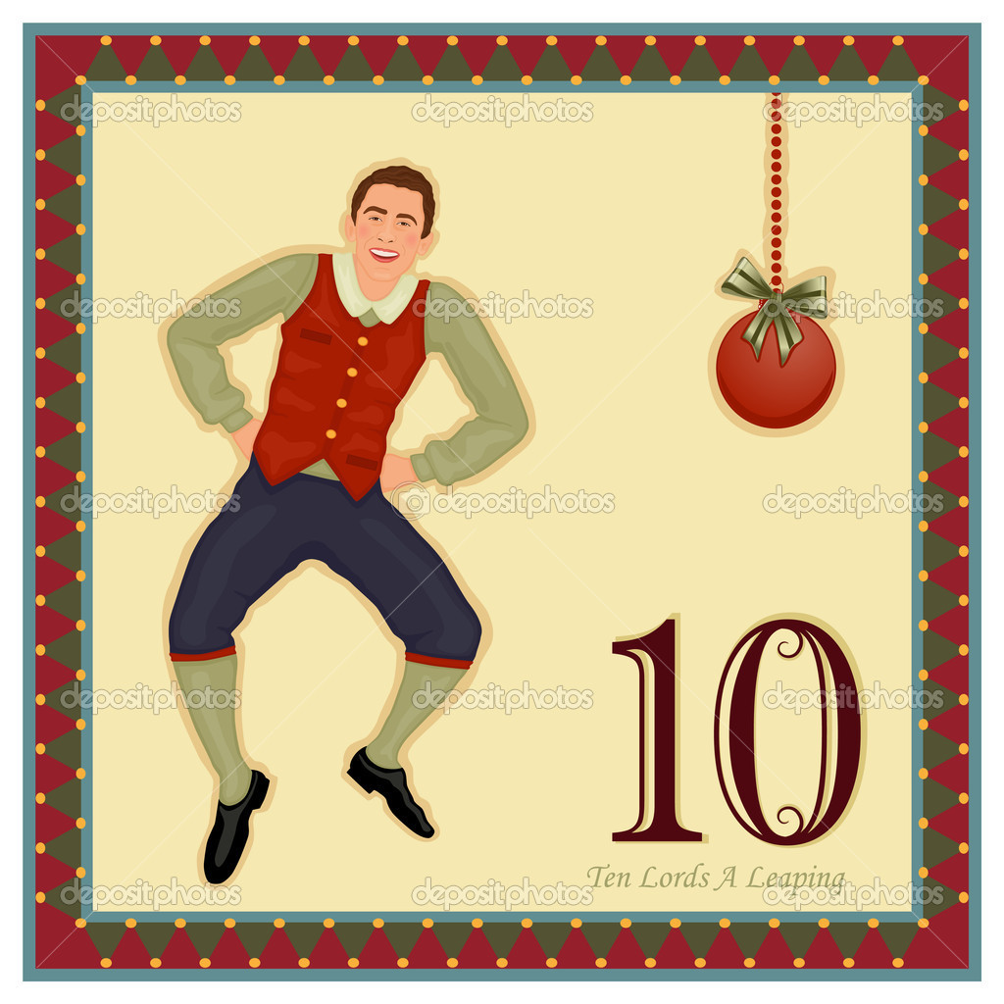
The ten lords a-leaping were the Ten Commandments.

Slide 14
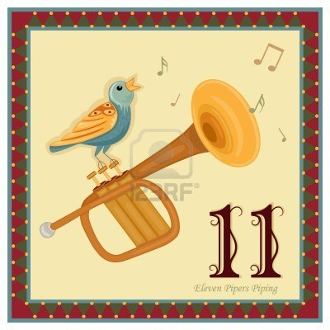
Eleven pipers piping stood for the eleven faithful disciples.

Slide 15
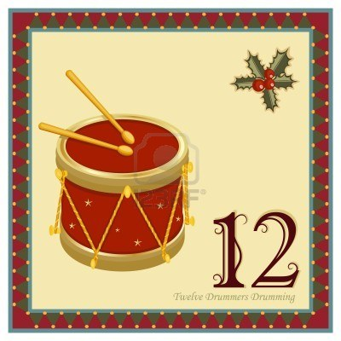
Twelve drummers drumming symbolized the twelve points of belief in the Apostles’ Creed.

Slide 16
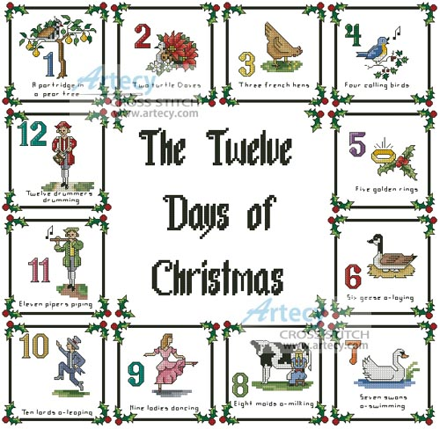
Let us sing
all twelve together….
You know how to, without every word shown to you.

Slide 17
On the twelfth day of Christmas, My true love gave to me, Twelve drummers drumming, Eleven pipers piping, Ten lords-a-leaping, Nine ladies dancing, Eight maids-a-milking, Seven swans-a-swimming, Six geese-a-laying, Five golden rings, Four calling birds, Three French hens, Two turtle doves, And a partridge in a pear tree.
On the first day of Christmas my true love gave to me a partridge in a pear tree. On the second day of Christmas, My true love gave to me, Two turtle doves, And a partridge in a pear tree.

