Slide 1
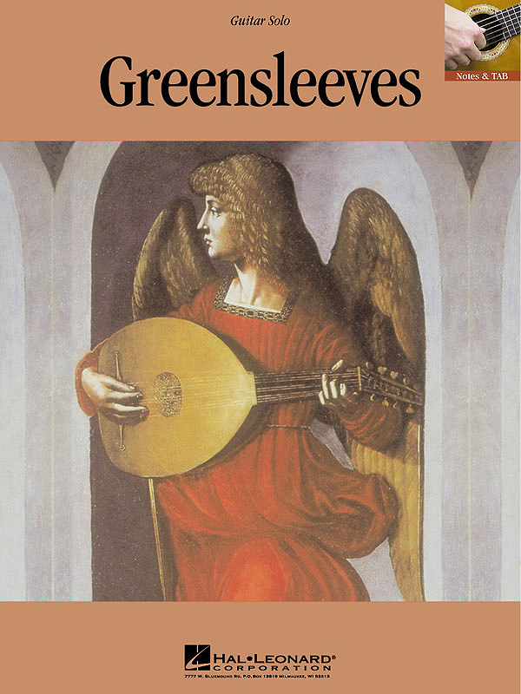

Slide 2
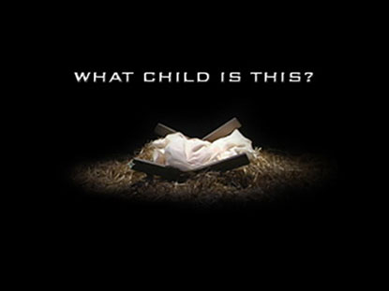
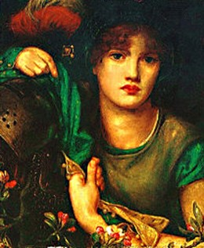
What Child is This Words were written by William Chatterton Dix.
Music: Greensleeves, was an olde English melody.

Slide 3
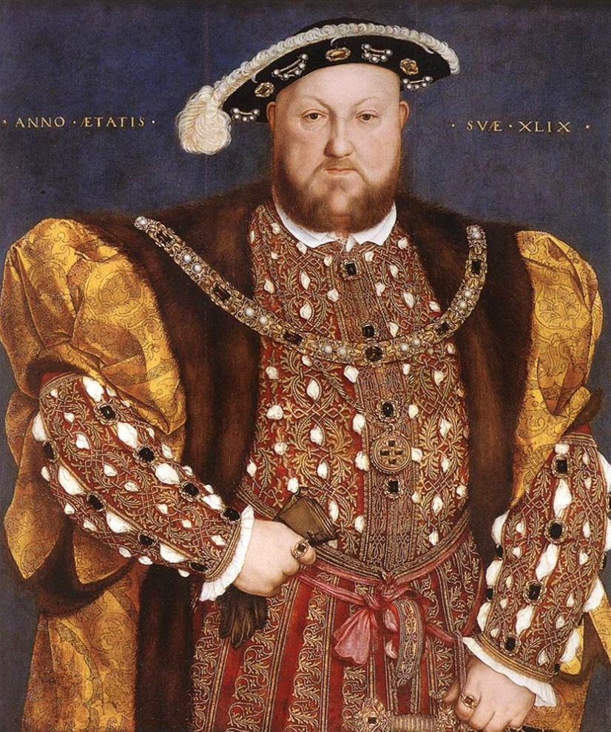
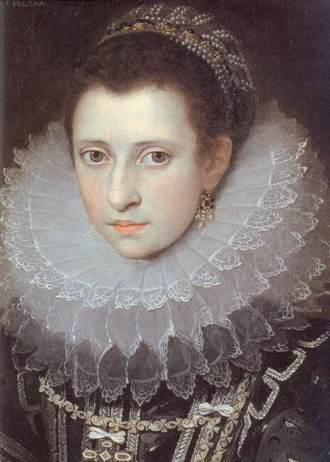
Greensleeves was not
written by Henry VIII to
Anne Boleyn
as was thought.
It is an Italian form that came to England in the
Elizabethan period.

Slide 4
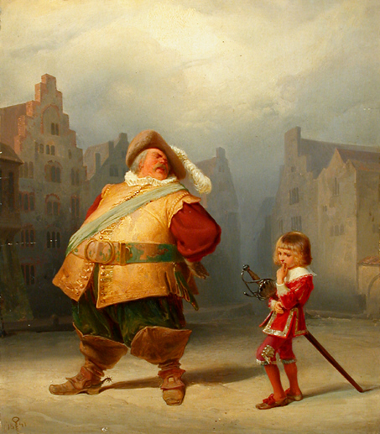
William Shakespeare makes three references to the song in The Merry Wives of Windsor.
Falstaff:
Let the sky rain potatoes!
Let it thunder to the tune
of 'Greensleeves'!

Slide 5
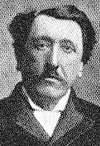
At the age of twenty-nine, he was struck with a sudden near-fatal illness and confined to bed rest for several months He went into a deep depression.
Author William Chatterton Dix was
born in Bristol, England,
the son of a surgeon.

Slide 6
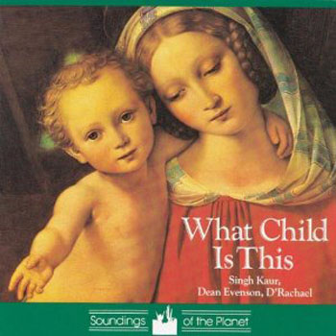
Yet out of his near-death experience, in 1865, Dix wrote many hymns, including a poem entitled, "The Manger Throne," from which three stanzas were
later culled, and
retitled as
"What Child Is This?"

Slide 7
The song begins in the manger with the child sleeping on Mary's lap, accompanied by angels and shepherds. But the second verse asks why he would be lying "in such mean estate.“
It goes on to speak of Jesus' purpose –– to plead for the salvation of sinners.
The third verse moves to a joyful tone.
Join us in singing it now.

Slide 8
What child is this, who, laid to rest, On Mary's lap lay sleeping? Whom angels greet with
anthems sweet, While shepherds watch are keeping? This, this is Christ the King, Whom shepherds guard and angels sing: Haste, haste to bring Him laud, The Babe, the son of Mary.
Why lies he in such mean estate Where ox and ass are feeding? Good Christian, fear:
for sinners here The silent Word is pleading.
This, this is Christ the King, Whom shepherds guard and angels sing: Haste, haste to bring Him laud, The Babe, the son of Mary.
So bring him incense, gold, and myrrh, Come, peasant, king, to own him. The King of kings salvation brings, Let loving hearts enthrone him.
This, this is Christ the King, Whom shepherds guard and angels sing: Haste, haste to bring Him laud, The Babe, the son of Mary.

