Slide 1
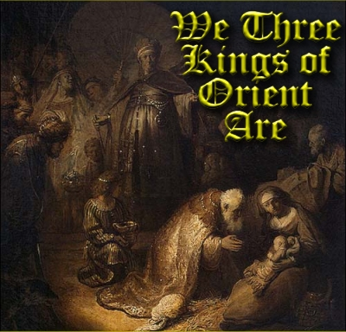

Slide 2
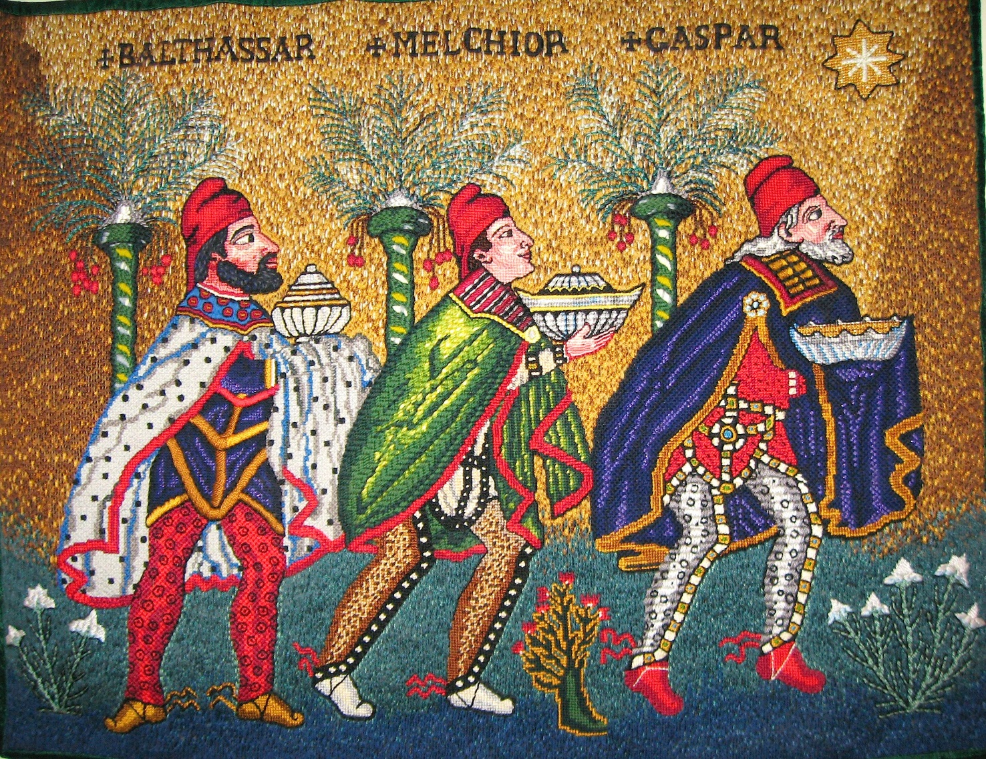
The Three Kings were Balthassar, Melchior and Caspar.
They gave gifts of Gold, Frankincense and Myrrh.
The history of We Three Kings is nicely shown in this 4 minute video.

Slide 3
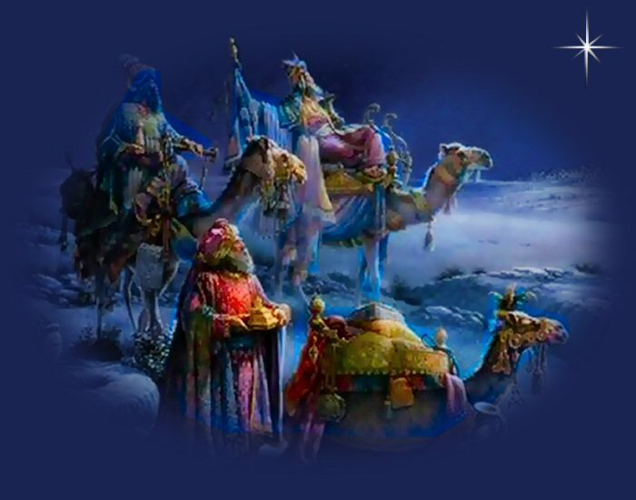
http://www.youtube.com/watch?v=obW3pLDHP5w

Slide 4
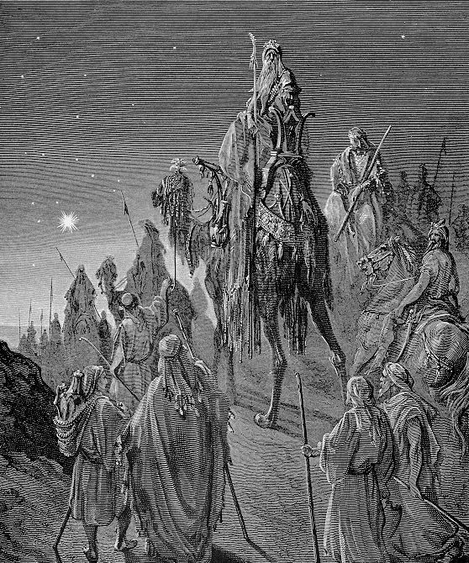
Join us in singing
We Three Kings
of Orient Are

Slide 5
We three Kings of Orient are
Bearing gifts we traverse afar.
Field and fountain, moor and mountain, following yonder star
O star of wonder, star of night,
Star with royal beauty bright,
Westward leading, still proceeding,
Guide us to the perfect Light.
Born a king on Bethlehem’s plain,
Gold I bring to crown him again,
King forever, ceasing never
Over us all to reign.
O star of wonder, star of night,
Star with royal beauty bright,
Westward leading, still proceeding,
Guide us to the perfect Light.

