Slide 1
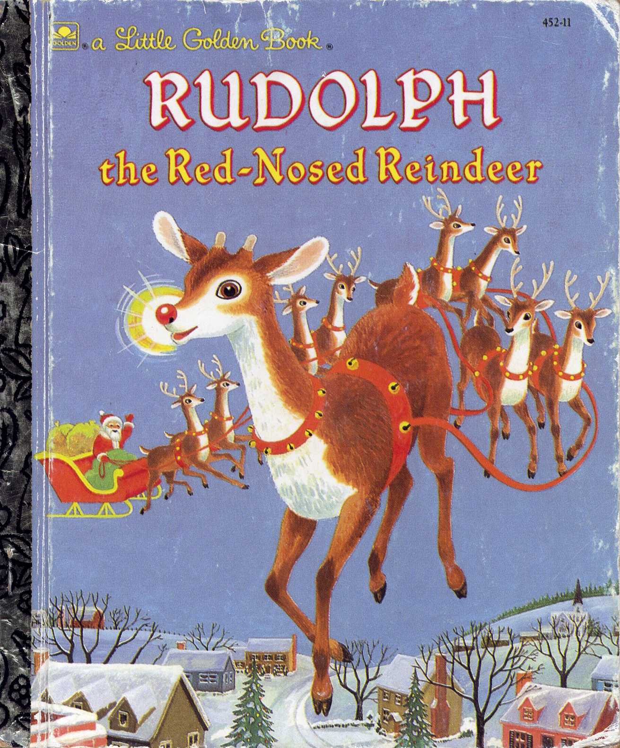

Slide 2
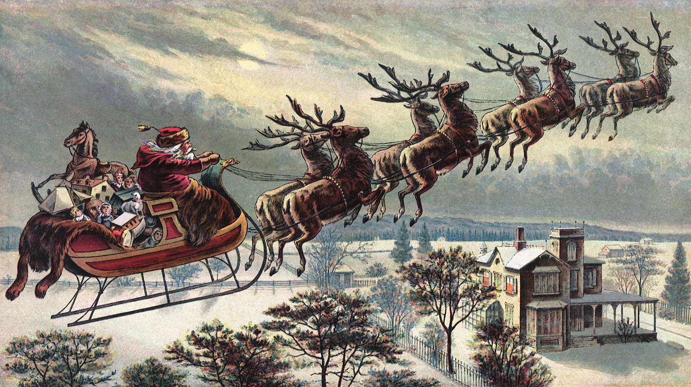
You know Dasher and Dancer and Prancer and Vixen because of the 1824 poem "A Visit From St. Nicholas" (aka "'Twas the Night Before Christmas"),

Slide 3
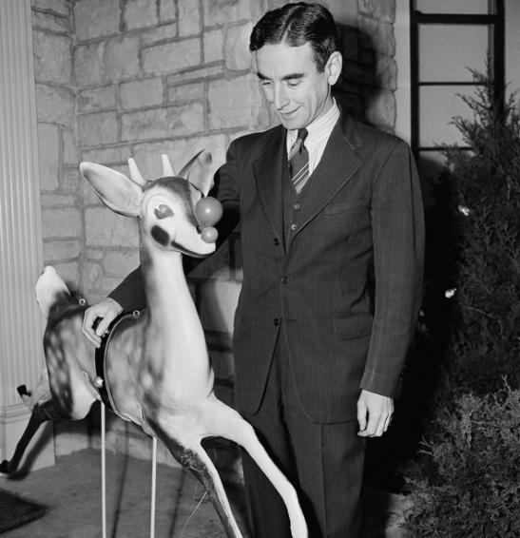
but your knowledge of Rudolph—the most famous reindeer of all—comes courtesy of a department store copywriter named Robert L. May, May's songwriter brother-in-law who set his words to music and the singing cowboy who made a household name of May's creation.

Slide 4
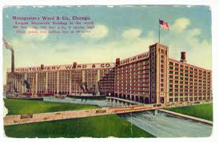
The story of "Rudolph the Red-Nosed Reindeer" begins in 1939 at Montgomery Ward, the Chicago-based retail and catalog giant.

Slide 5
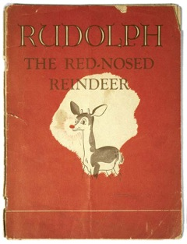
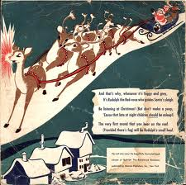
Seeking a cheaper holiday giveaway than the children's coloring books they had purchased and distributed in years past, Montgomery Ward asked its own marketing department to create a new and original Christmas storybook from scratch.

Slide 6
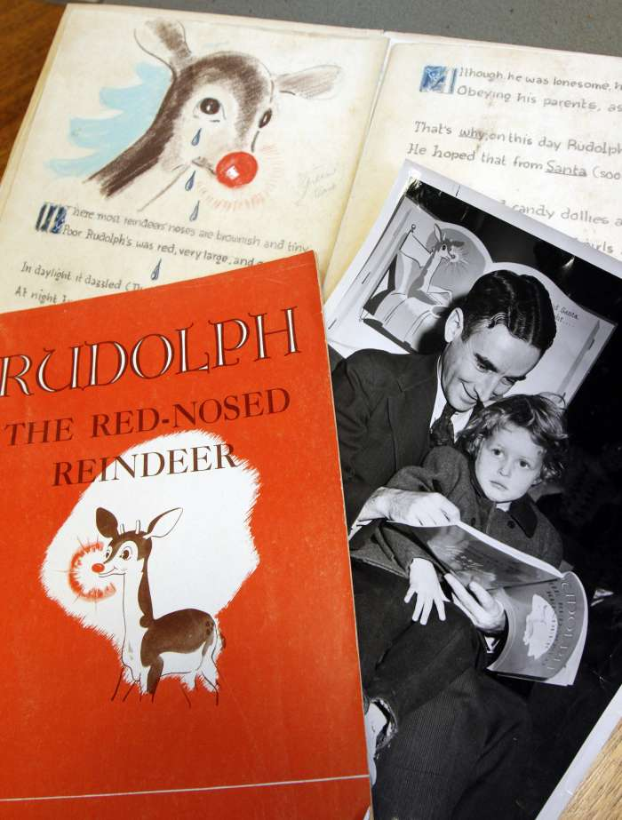
The task fell to May, a family man with a four-year-old daughter. The story that May wrote was given away to more than 2 million Montgomery Ward customers in 1939. It was not until May's brother-in-law adapted the story into song almost 10 years later, however, that "Rudolph" truly entered the national consciousness.

Slide 7
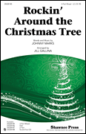
May's brother-in-law was a professional songwriter named Johnny Marks, best known for works like "Rockin' Around the Christmas Tree" (1958) and "A Holly Jolly Christmas" (1962) in addition to "Rudolph."

Slide 8
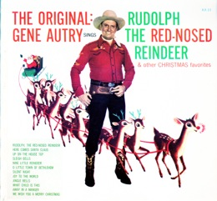
In 1949, Marks' song found its way to radio legend Gene Autry, the original Singing Cowboy, whose recording of "Rudolph" sold more than 2 million units in its first year alone on its way to becoming the second-most successful
Christmas record in history
(after "White Christmas").

Slide 9
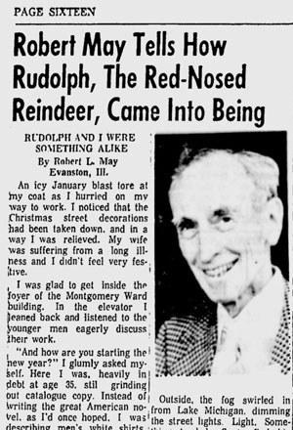
It is at this point in the story of "Rudolph" when those with a nose for legal issues begin to wonder who owned the rights to the beloved Christmas story and money-making juggernaut. In fact, as a paid employee of Montgomery Ward, author Robert L. May had no legal claim whatsoever to an ownership stake in "Rudolph."

Slide 10
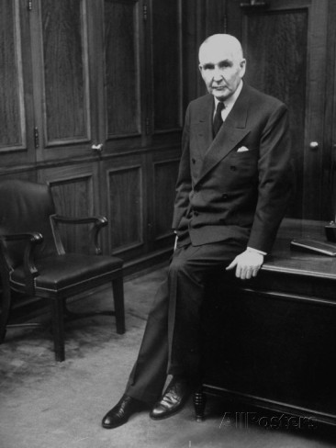
Furthermore, May was a widowed single father by 1947, facing enormous debts as a result of his wife's terminal illness. Yet in a twist that will boggle the minds and warm the hearts of those hardened to the ways of modern American capitalism, the president of Montgomery Ward, one Sewell Avery, signed over to Robert L. May 100 percent of the "Rudolph" copyright in January 1947.

Slide 11
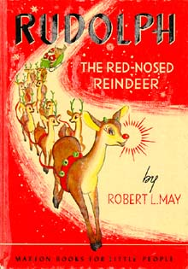
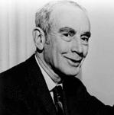
May lived comfortably on the royalties from "Rudolph the Red-Nosed Reindeer" until his death in 1976.

Slide 12
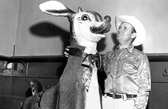
Rudolph himself turns 75 in January 2014.
Join us in singing it now.

Slide 13
Rudolph the red-nosed reindeer
Had a very shiny nose.
And if you ever saw him,
You would even say it glows.
All of the other reindeer
Used to laugh and call him names.
They never let poor Rudolph
Play in any reindeer games.
Then one foggy Christmas eve,
Santa came to say:
“Rudolph with your nose
so bright,
Won’t you guide my
sleigh tonight?”
Then all the reindeer loved him
As they shouted out with glee:
“Rudolph the red-nosed reindeer,
You’ll go down in history!”
Then one foggy Christmas eve,
Santa came to say:
“Rudolph with your nose so bright,
Won’t you guide my sleigh tonight?”
Then all the reindeer loved him
As they shouted out with glee:
“Rudolph the red-nosed reindeer,
You’ll go down in history!”

