Slide 1
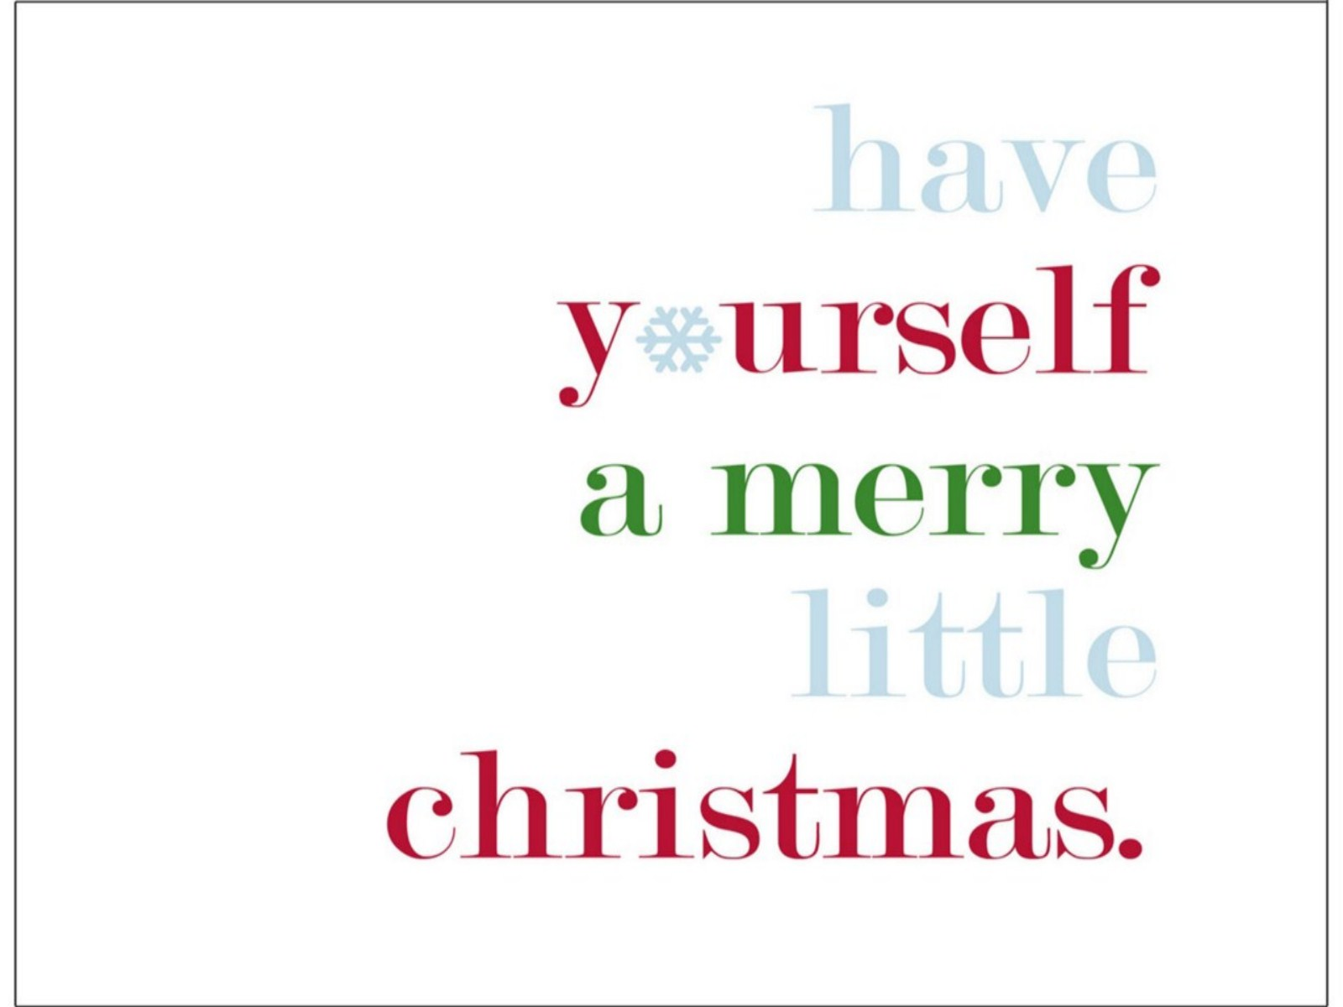

Slide 2
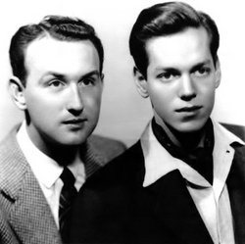
Have Yourself a Merry Little Christmas was first published in 1943. The words were written by Ralph Blane (right) and the music was composed by Hugh Martin (left).

Slide 3
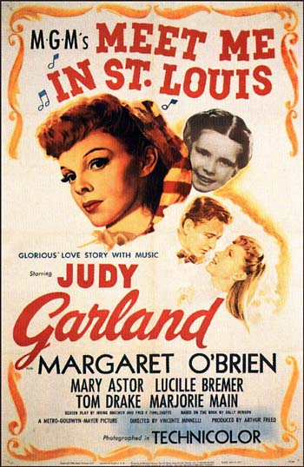
This Christmas carol was written for the musical Meet Me in St. Louis.

Slide 4
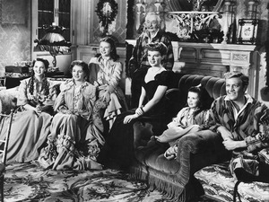
Judy Garland performed the song in movie. Some people believe it is one of the saddest Christmas songs ever written.

Slide 5
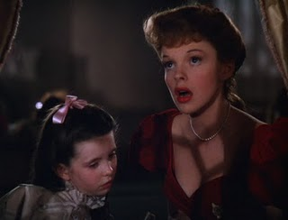
The original lyrics were
very sad and depressing.
Judy Garland thought the
words were too dark to
sing to the child who played her little sister in the movie. About a week before filming the lyrics were changed from “have yourself a merry little Christmas, it may be your last…faithful friends who are dear to us, will be near to us no more” to “have yourself a merry little Christmas, let your hearts be light, from now on our troubles will be out of sight”.

Slide 6
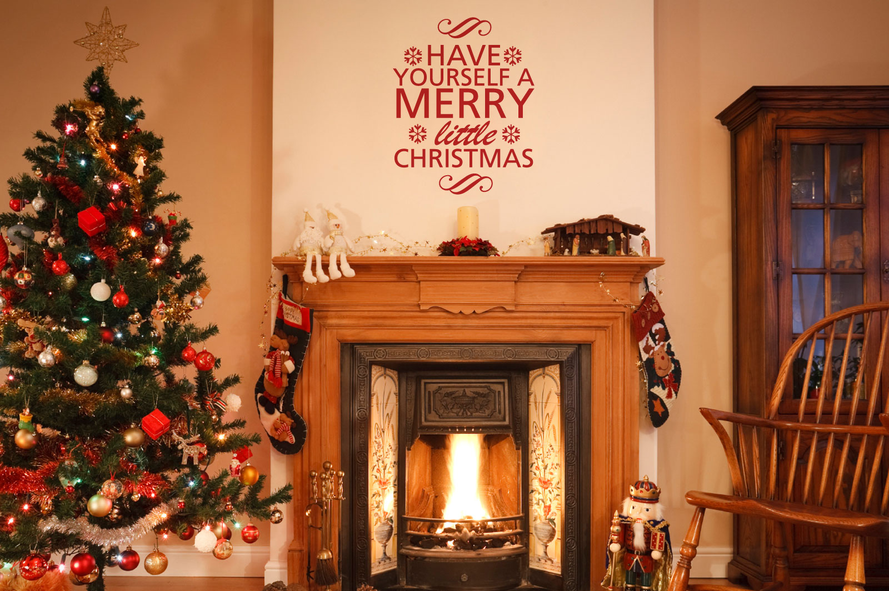
In recent years, Have Yourself a Merry Little Christmas has been ranked as one of the most performed Christmas songs.

Slide 7
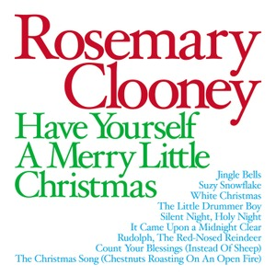
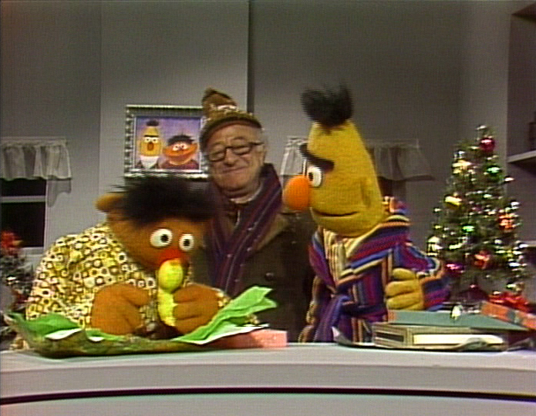
It has been recorded and performed by many different artists including Perry Como, Rosemary Clooney, The Carpenters, James Taylor, Garth Brooks and even a few Muppets have put there spin on this classic Christmas tune.

Slide 8
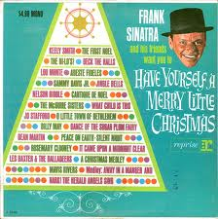
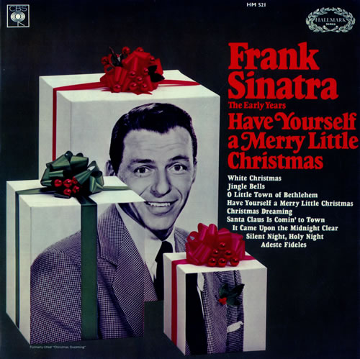
Frank Sinatra happens to have his own version of the song with more upbeat lyrics than the original two.

Slide 9
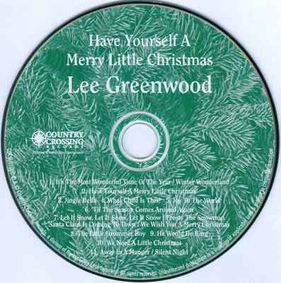
Have Yourself a Merry Little Christmas has gone through several changes but it remains a very popular Christmas carol today.
Please sing along.

Slide 10
Have yourself a merry little Christmas, Let your heart be light Next year all our troubles will be out of sight Have yourself a merry little Christmas, Make the Yule-tide gay, Next year all our troubles will be miles away Once again as in olden days, Happy golden days of yore. Faithful friends who are dear to us Will be near to us once more. Some day soon we all will be together If the Fates allow Until then we'll have to muddle through some how. so have yourself a merry little Christmas now.

